Slide 1
Older Americans Act, State Programs and MN’s Aging Network: Leveraging Strengths During Pandemic
Reena Shetty| Staff | Minnesota Board on Aging
Kjersta Meium | Staff | Minnesota Board on Aging
Mike Saindon | Staff | Minnesota Department of Human Services

Slide 2
Overview
The Aging Network
Aging Network and Federal Pandemic Funds
MN’s LTSS System
Demographic Highlights
MN2030: Looking Forward
Governor’s Council on Age-Friendly MN

Slide 3
The Aging Network – Older Americans Act

Slide 4
Relationship Between the Older Americans Act & MBA
2
Defines Federal, State & Local Roles in Administering OAA programs & services
Establishes OAA Programs & Services, funding formulas & match requirements
Specifies target populations & data reporting requirements
Older Americans
Act
Designated State Unit on Aging
Administers funds and programmatic oversight for Area Agencies on Aging, Dementia grants, Senior Corps programs
MN Board on Aging

Slide 5
A Summary of State Coronavirus Funding to Date
The Families First Coronavirus Response Act (P.L. 116-127)
The Coronavirus Preparedness and Response Supplemental Appropriations Act (P.L. 116-123)
The Coronavirus Aid, Relief, and Economic Security (CARES) Act (H.R. 748)
Notes:
FAMILIES First: which addressed Medicaid matching rates, nutrition assistance, unemployment insurance, paid sick and family leave, and diagnostic testing costs.
CARES:
SUPPLEMENTAL: which provided about $8 billion focused on public health, including at least $1.05 billion for state and local governments.
Next Steps - A fourth relief bill may soon be considered. A driving impetus for another relief package is concern that states need additional assistance to deal with declining revenues and rising costs.

Slide 6
Older Americans Act Programs & Waiver Programs
Supporting providers to shift service delivery to:
Meal delivery
Prescription drug delivery
Telephone reassurance
Online/phone caregiver consultation and support groups
Online health promotion classes
Emergency home modifications and outdoor chore
Notes:
Mike’s Slides
Executive Order 20-12: Waivers under peacetime emergency authority
– State grant, adult

Slide 7
Grant Programs
Senior Volunteer Programs
Shifting to telephone reassurance
Pen pal/e-mail
Online exercise classes
DHS Live Well at Home Grants
Grant deadline
Contract extensions/amendments
Notes:
Mike’s Slide

Slide 8
Statewide Initiatives
Statewide Emergency Operations Center (SEOC)
Triage protocol with Senior LinkAge Line®
Problem solving to meet nutrition needs of older adults
Governor’s COVID-19 Workgroups
At-Risk Populations Work Group
Food Security Work Group
Notes:
Kjersta’s Slide Fully serve people who are already receiving publicly-funded services
Elderly Waiver, Alternative Care, Essential Community Supports
Older Americans Act
Current meal recipients, in-home/supportive services recipients and caregiver support services recipients
Start to serve people who are at risk and “pre-eligible”
Low income, solo seniors, Native American elders and elders from cultural and ethnic communities

Slide 9
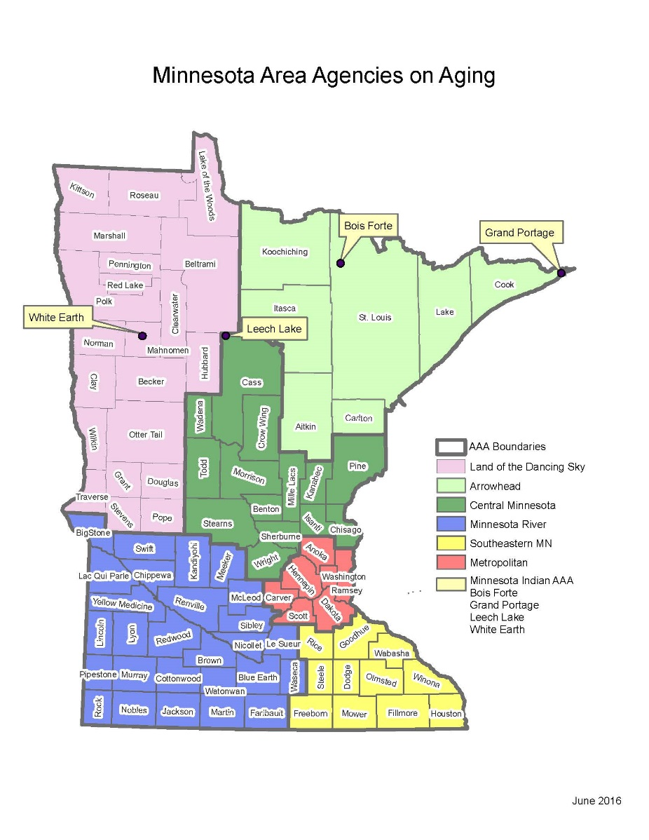
Minnesota Area Agencies on Aging
Dancing Sky AAA
Arrowhead Area Agency on Aging
Central Minnesota Council on Aging
Minnesota River Area Agency on Aging
Southeastern Minnesota AAA
Metropolitan Area Agency on Aging
Minnesota Indian AAA
Notes:
Land of the Dancing Sky AAA
Counties served: Becker, Beltrami, Clay, Clearwater, Douglas, Grant, Hubbard, Kittson, Lake of the Woods, Mahnomen, Marshall, Norman, Otter Tail, Pennington, Polk, Pope, Red Lake, Roseau, Stevens, Traverse & Wilkin.
Arrowhead Area Agency on Aging
Counties served: Aitkin, Carlton, Cook, Itasca, Koochiching, Lake, & St. Louis
Central Minnesota Council on Aging
Counties served: Benton, Cass, Chisago, Crow Wing, Isanti, Kanabec, Mille Lacs, Morrison, Pine, Sherburne, Stearns, Todd, Wadena, & Wright.
Minnesota River Area Agency on Aging, Inc.
Counties served: Big Stone, Blue Earth, Brown, Chippewa, Cottonwood, Faribault, Jackson, Kandiyohi, Lac qui Parle, Le Sueur, Lincoln, Lyon, Martin, McLeod, Meeker, Murray, Nicollet, Nobles, Pipestone, Redwood, Renville, Rock, Sibley, Swift, Waseca, Watonwan, & Yellow Medicine.
Southeastern Minnesota AAA
Counties served: Dodge, Fillmore, Freeborn, Goodhue, Houston, Mower, Olmsted, Rice, Steele, Wabasha, & Winona.
Metropolitan Area Agency on Aging
Counties served: Anoka, Carver, Dakota, Hennepin, Ramsey, Scott, & Washington
Minnesota Indian AAA
Reservations Served: Bois Forte, Grand Portage, Leech Lake, & White Earth.

Slide 10
Older Americans Act (OAA): Key Programs & Services
Access Services – Senior LinkAge Line®, Information & Assistance, Referral & Outreach
Supportive Services –Chore Assistance, Homemaker services, Home Modifications, Assisted Transportation, Legal Assistance, etc.
Nutrition Services – Congregate & Home Delivered Meals
Health Promotion/Disease Prevention—Evidence based programs to assist older adults maintain their health, avoid injuries, and manage chronic health/behavioral health conditions

Slide 11
Key Programs & Services (cont.)
Caregiver Support Services – Information & Assistance, counseling
and supportive services, training, and respite
LTC Ombudsman Program
Advocates for the rights of LTC residents
Identifies, investigates, & resolves complaints made by (or on behalf of) LTC facility residents.
Conducts community education about LTC services and issues
Notes:
Survey the group
NFCSP requires States to provide 5 types of services:
info. to c/g about available services
Assistance to c/g in gaining access to services
Ind. Counselling, support groups & c/g training
Respite care
Supplemental services

Slide 12
Overview of MN’s Long-Term Services and Supports System

Slide 13
Long-Term Services and Supports System for Older Adults
Increasing Need
Caregiving
Providers and Volunteers
Notes:
Mike and Reena

Slide 14
Access: Senior LinkAge Line
Who
Help at home
New to Medicare
Living in nursing home
Can’t afford medications
Tired caregiver
How
Research options
Explain benefits
Develop a support plan
Apply for Rx programs
Find support and respite
Notes:
Types of Resources
The LinkAge Line is one of the state’s front lines of support to help people age-in-place; that is:, to live where and how they want.
This means we can help find transportation, an affordable place to live, meal delivery, and getting help with household chores. And if you qualify, we help you find programs that pay for essentials like prescription drugs and heating bills.
The Senior LinkAge Line also helps the family and friends– the family caregivers – who truly enable older people to stay at home. They need support and resources, too. So it is not only people over 60 who call the LinkAge line, it can be a person of any age who helps an older Minnesotan at home.

Slide 15
Senior LinkAge Line: How to Connect
Call, chat or in-person
Publications:
Online: MinnesotaHelp.info or SeniorLinkAgeLine.com

Slide 16
Home & Community-Based Services & Supports
Older Americans Act: Eligibility and Targeting
Greatest Economic Need
Greatest Social Need
At-risk of Institutionalization
Notes:
Economic Need – Income level at or below poverty level
Social Need – resulting from non-economic factors including physical and mental disabilities, language barriers, cultural, social & geographic isolation
At-risk – unable to perform at least 2 ADLs w/out assistance & determined at-risk of placement in a LTC facility

Slide 17
DEMOGRAPHIC HIGHLIGHTS
Notes:
Reena

Slide 18
Minnesota has already begun the transition to an older state
Source: U.S. Census Bureau, State Demographer’s Office
Notes:
Reena
Total population: 5.52 million
Total 65+: 806,000 in 2015
About 825,000 now; which represents 15% of the population
The number of Minnesotans turning 65 in this decade (about 285,000) will be greater than the past four decades combined.
Around 2020, Minnesota's 65+ population is expected to eclipse the 5-17 K-12 population, for the first time in history.
The total number of older adults (65+) is anticipated to double between 2010 and 2030, according to our projections. By then, more than 1 in 5 Minnesotans will be an older adult, including all the Baby Boomers.

Slide 19
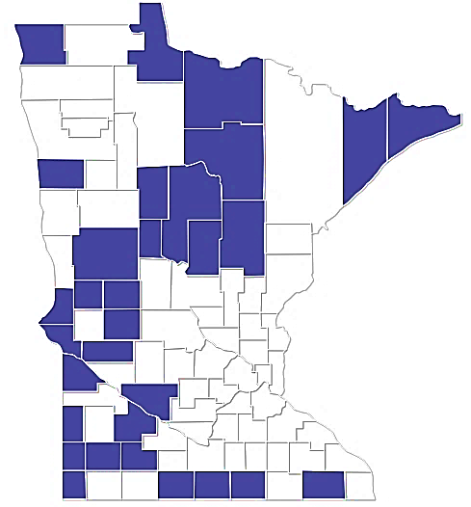
Demographic Highlights
2013
Counties (31) where at least 1 in 5 residents were 65+
Notes:
Mike

Slide 20
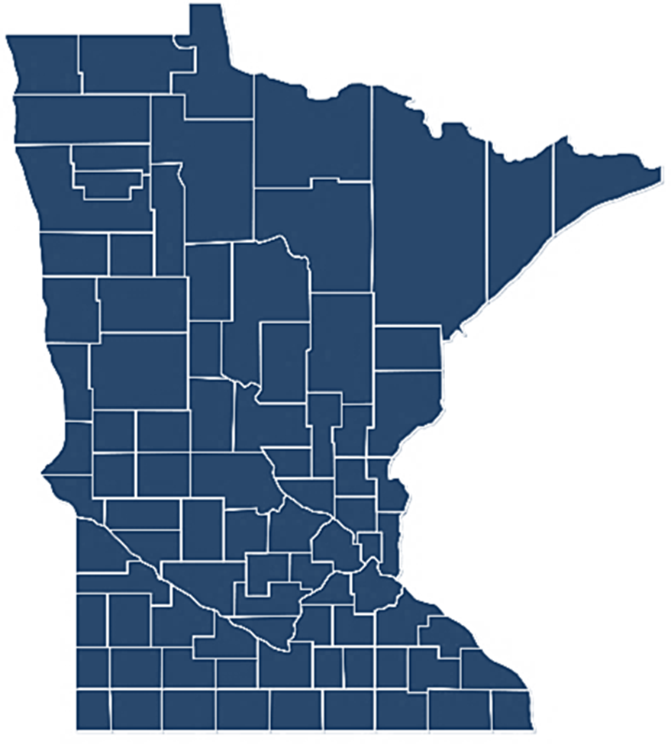
Demographic Highlights
2030
Counties (87) where at least 1 in 5 residents were 65+
Notes:
Mike

Slide 21
Projected Growth in Labor Force Annual Average, Ages 16+
Source: U.S. Census Bureau, Minnesota State Demographic Center Projections
Notes:
Reena

Slide 22
State Grants
Live Well at Home
Senior Companion, Foster Grandparents & RSVP
Eldercare Development Partnership Grants
MBA Dementia Grants
MBA/DHS
Notes:
Mike

Slide 23
MN2030 Looking Forward and Age-Friendly - Process
May 2019
Meeting with 23 State Agencies
AARP Age-Friendly State Process
LTSS Status Checks
Launch Designation Process (2020)
Spring 2017 MN2030: Looking Forward – Started by MBA and DHS
2018
September 2019 Request to Governor
2019
March 2019
Collaboration with MN Leadership Council on Aging
Executive Order
November/December
Community Conversations
2017
Notes:
Mike starts – MN2030
Phase 1: Governor Walz signs an executive order indicating commitment to the age-friendly designation and establishing the Age-Friendly Advisory Board.
Phase 2: State completes a comprehensive assessment and action plan (Year 1)
Phase 3: State implements, provides annual updates and evaluates work (Years 2-5)
Phase 4: State participates in continuous improvement (Years 5+)
WHO and the AARP created a global network of age friendly states, cities and communities for our rapidly aging population
Age-friendly or livable communities have walkable streets, housing and transportation options, access to key services and opportunities for residents to participate in community activities.
States are encouraged to prepare for the rapid aging of the U.S. population by paying increased attention to the environmental, economic and social factors that influence the health and well-being of older adults.
By doing so, these communities are better equipped to become great places, and even lifelong homes, for people of all ages

Slide 24
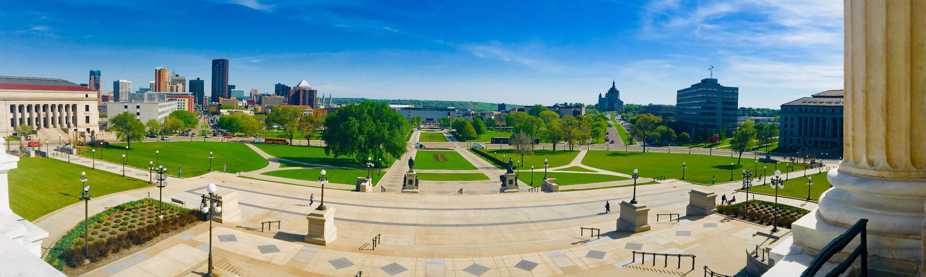
Governor’s Council on Age-Friendly Minnesota
https://mn.gov/dhs/age-friendly-mn/
Notes:
Reena

Slide 25
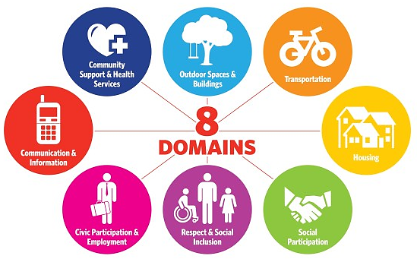
What is Age-Friendly?
The 8 Domains of Livability
Notes:
Reena

Slide 26
Discussion Topics
What service delivery changes have you made as a result of the Covid-19 public health pandemic?
Have you made new or unique partnerships as a result of the Covid-19 public health pandemic?
Aside from more financial resources what are your greatest needs to make it through the next three to six months? 12 months?

